Slide 1
Terminological work in Slovenia
Mojca Žagar Karer
Fran Ramovš Institute of the Slovenian Language
ZRC SAZU
Terminologifrämjandet, 9 March 2023

Slide 2
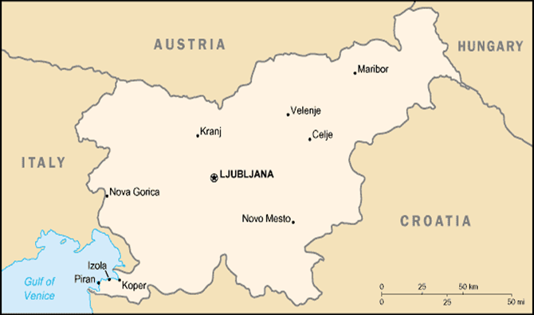
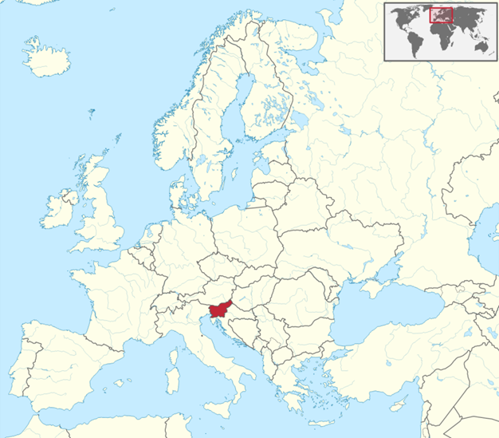
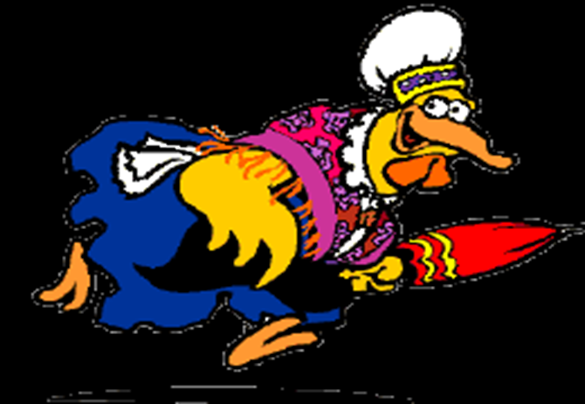
Slovenia

Slide 3
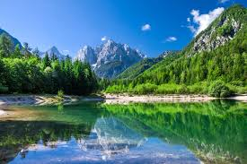
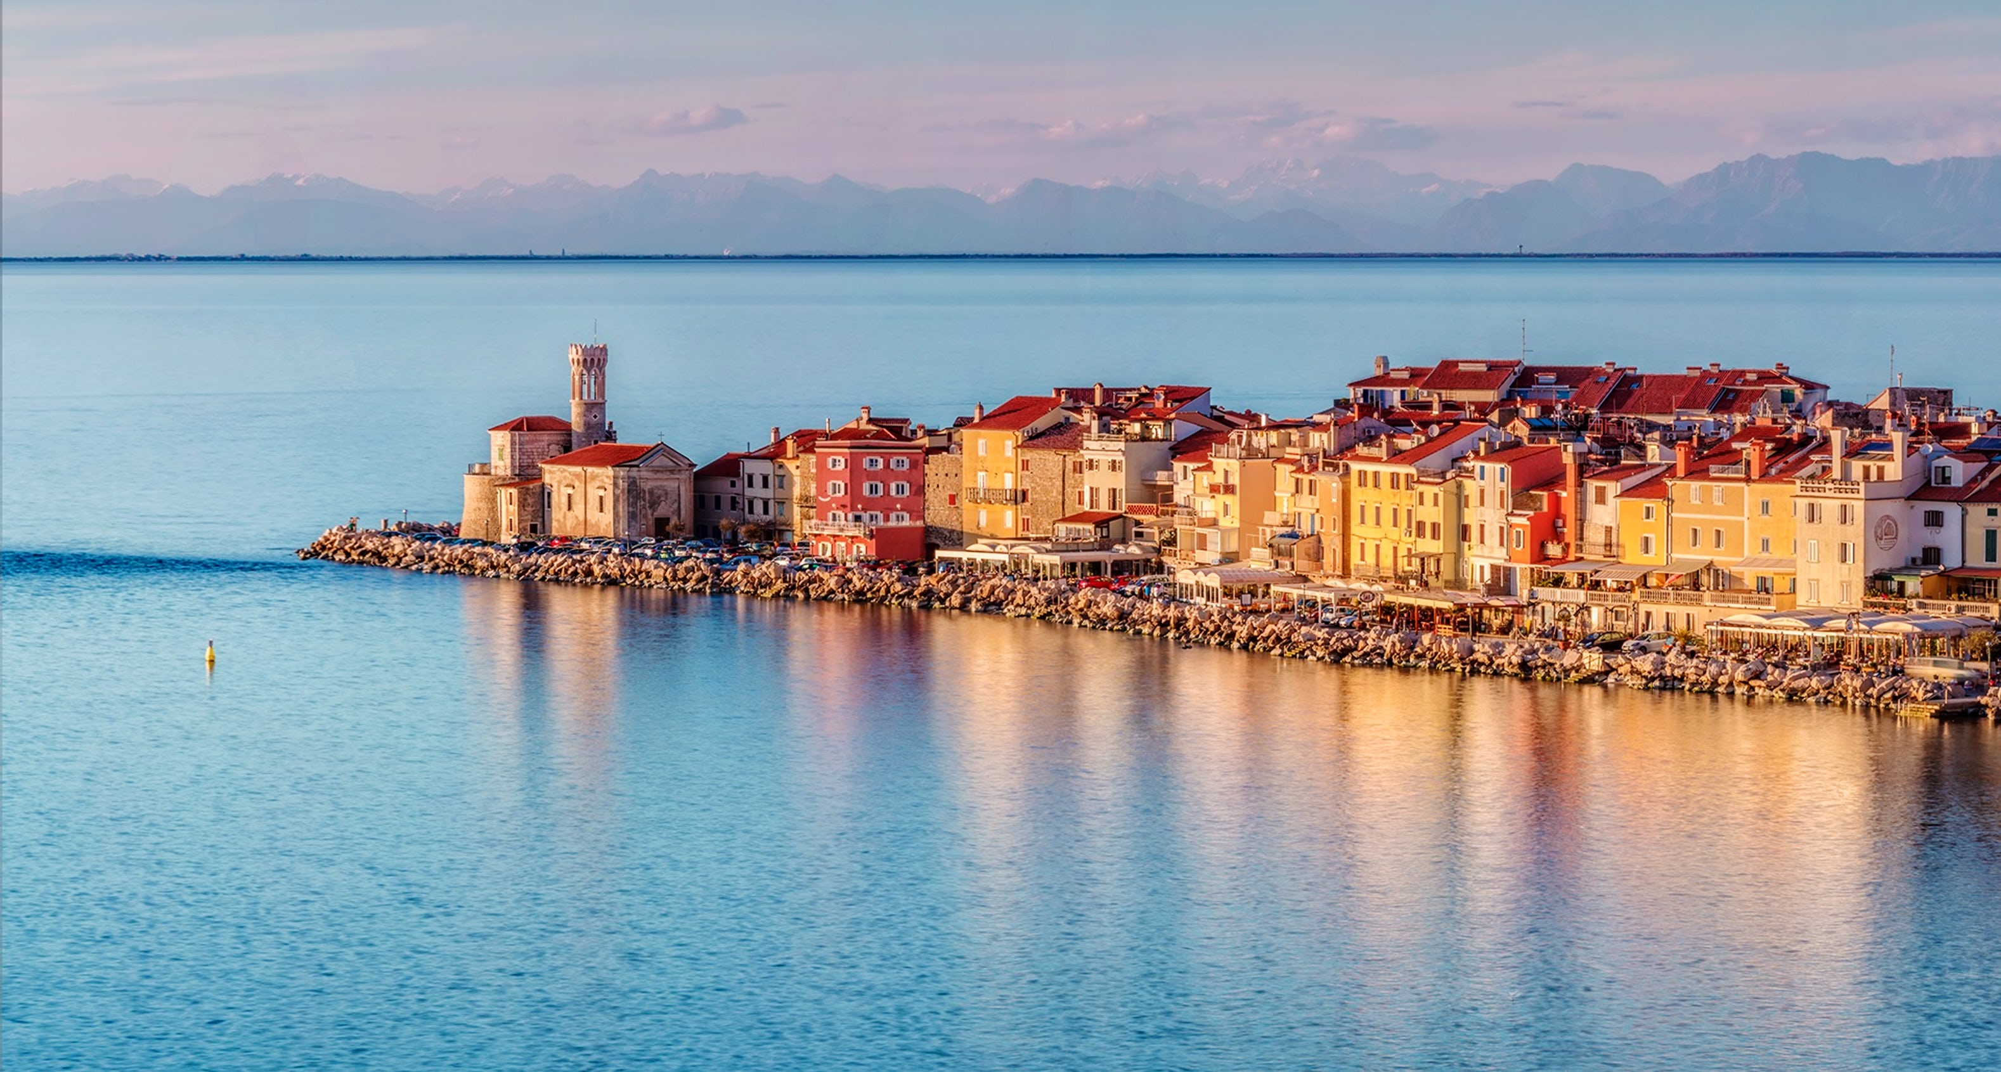
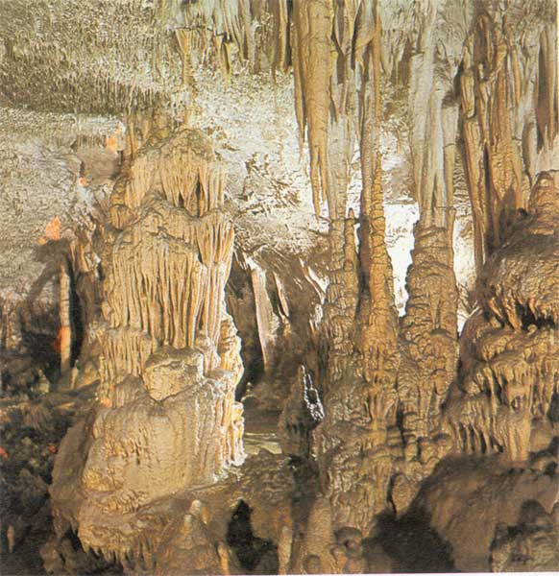
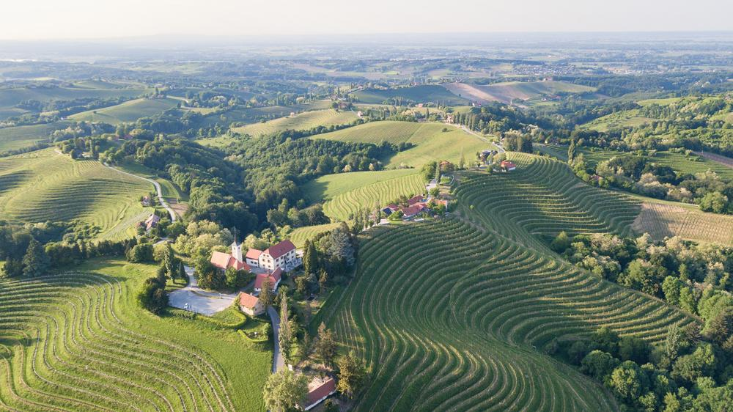
Facts about Slovenia
Population: 2.1 million
Capital city: Ljubljana
4 natural geographic regions: alpine, mediterranean, dinaric, pannonian

Slide 4
Slovenian history in a nutshell
On the crossroads between slavic, german and romance languages and cultures.
Its territory was part of the Roman Empire, the Byzantine Empire, the Carolingian Empire, the Holy Roman Empire, the Kingdom of Hungary, the Republic of Venice, the Illyrian Provinces of Napoleon's First French Empire, the Austrian Empire, and the Austro-Hungarian Empire (beetwen mid-14th century and 1918 under Habsburg rule).
20th century: 1918--1941: Kingdom of Yugoslavia; 1945--1991: Social Federal Republic of Yugoslavia (but not part of the Eastern Bloc).
25. June 1991: independence -- following independence referendum on 23. December 1990 (participation 93,4 %, of them 95 % opted for independence (88,5 % of all eligible voters)), „Ten-day war“, 1992 joined UN, 2004 joined EU and NATO.

Slide 5
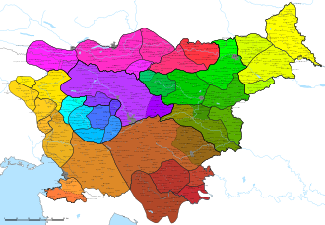
Slovenian language
Today: official language of Slovenia (first language for 88 %), along with Hungarian and Italian in their residential municipalities + official language of EU
South-slavic language
approx. 1000: Freising manuscripts: the oldest texts in Slovenian and the first Latin-script continuous text in any Slavic language.
1551: first book in Slovenian (Catechismus and Abecedarium by protestant Primož Trubar), 1584: first Grammar (by Adam Bohorič)
1851: standardization of Slovenian languge (based on different dialects)
Dialects: more than 40, 7 main groups
Curiosity: dual grammatical number

Slide 6
Terminological work in Slovenia
Almost 200 terminological dictionaries published in the last 20 years
Terminology collections for different purposes:
Terminologišče (https://isjfr.zrc-sazu.si/sl/terminologisce)
Termania (https://www.termania.net)
Evroterm (https://evroterm.vlada.si/)
IATE (https://iate.europa.eu)

Slide 7
Development of Slovene in a Digital Environment (DSDE project), 2020–2023
„The development of language technologies is crucial for the survival of a language in the digital age.“
5 working packages: language resources, speech technologies, semantic resources and technologies, machine translation, terminology portal
Terminology portal:
An aggregating search engine for the existing Slovene terminology resources (Terminologišče, Termania) and all resources that will be developed within the project framework.
An editor for terminological resource creation and accompanying guidelines and instructions, which will allow any user to create their own resources.
A tool for term extraction from standard written texts. It will be possible to import this tool into the editor and use it to create a terminological resource.
An integrated Terminological Counselling Service (FR Institute of the Slovenian Language ZRC SAZU).

Slide 8
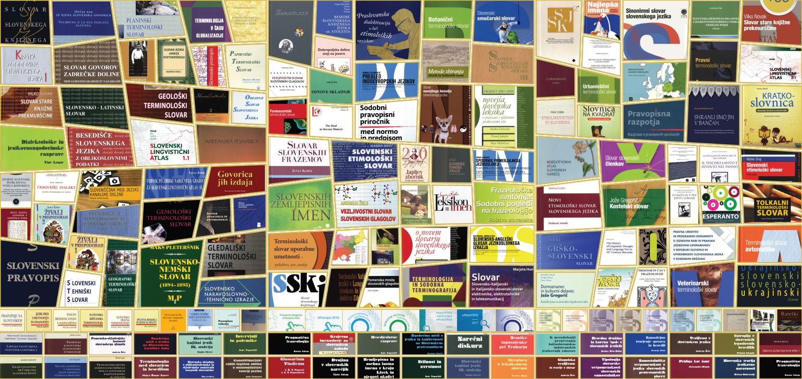
Fran Ramovš Institute of the Slovenian Language ZRC SAZU

Slide 9
Fran Ramovš Institute of the Slovenian Language ZRC SAZU
Established in 1945 for the purpose of compiling linguistic materials and using them for the creation of basic Slovenian language resources.
Today, it consists of:
Dialectological Section
Etymological-Onomastic Section
Lexicological Section
Orthographic Section
Section for Historical Dictionaries
Terminological Section

Slide 10
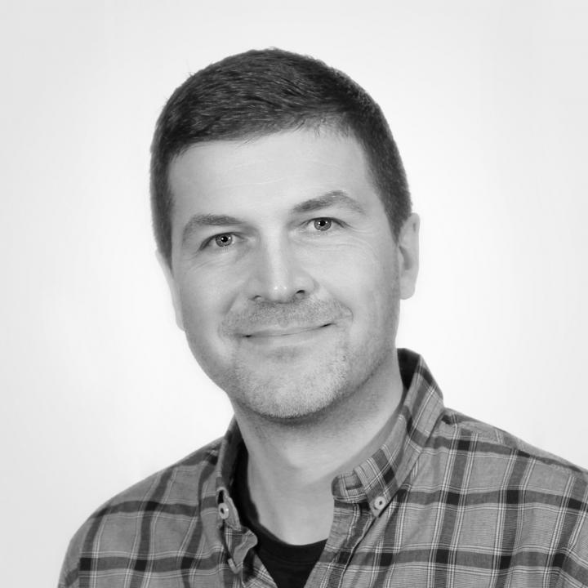
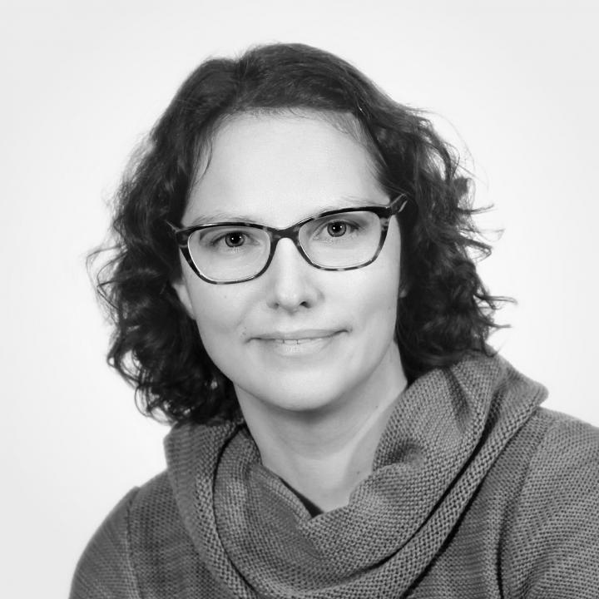
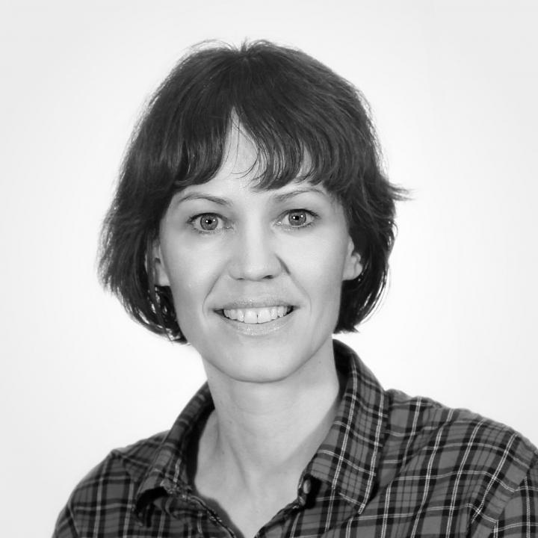
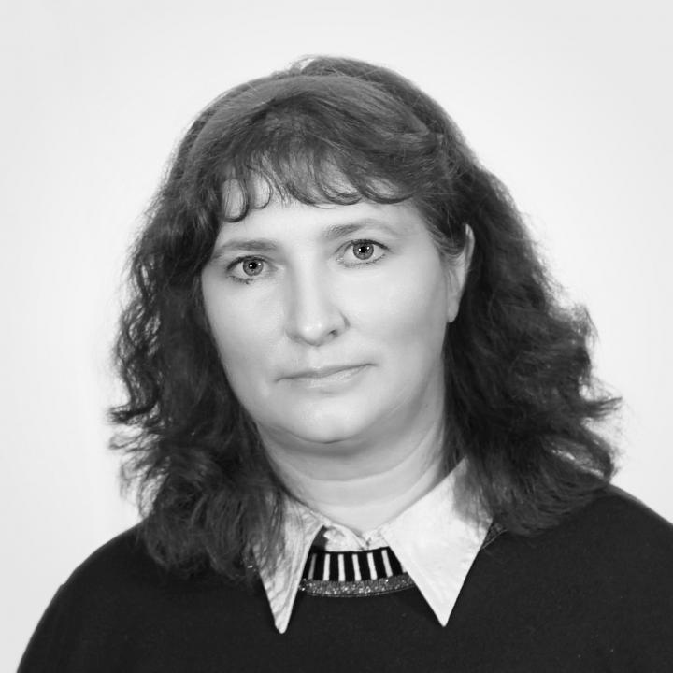
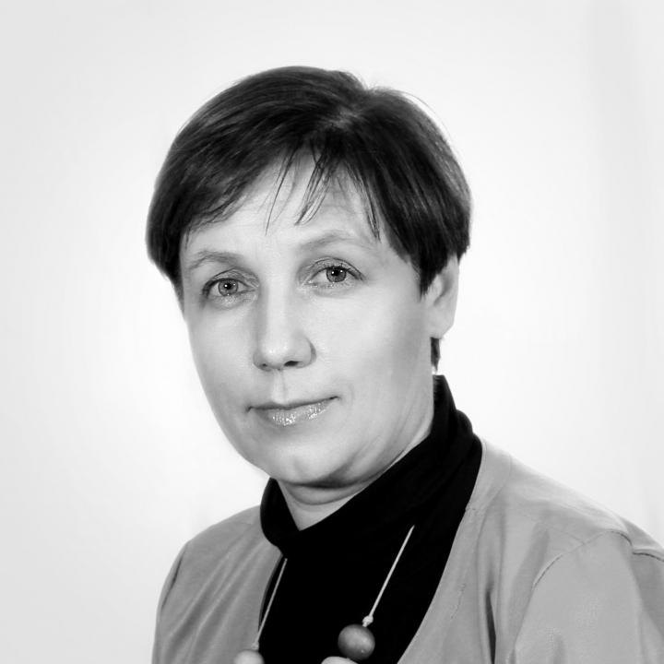
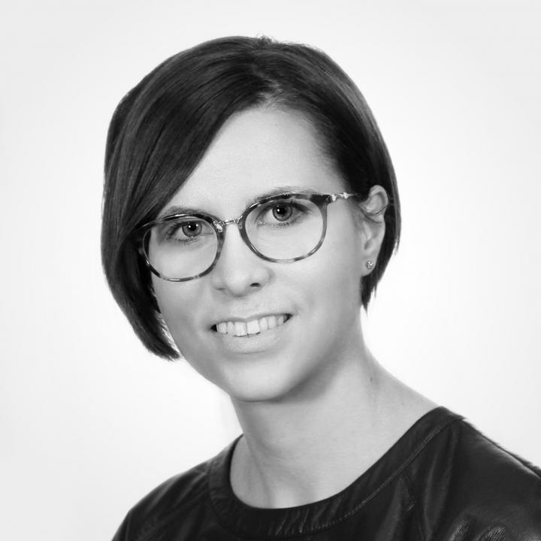
Terminological section

Slide 11

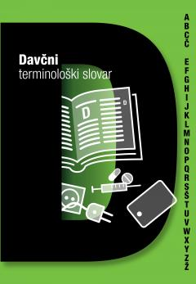
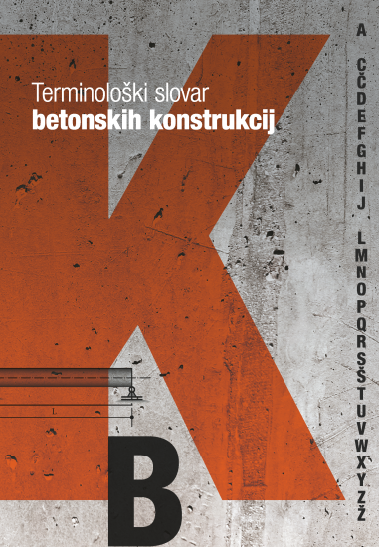
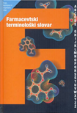
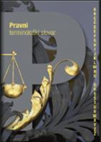
Terminological Section on Fran Ramovš Institute of the Slovenian Language ZRC SAZU
Terminological dictionaries – last 5 years:
Terminological dictionary of Stonemasonry (2022)
Terminological Dictionary of Taxes (2022)
Terminological Dictionary of
Concrete Structures (2021)
Pharmaceutical Terminological
Dictionary, 2nd ed. (2019)
Terminological Dictionary of
Legal Terminology (2018)

Slide 12
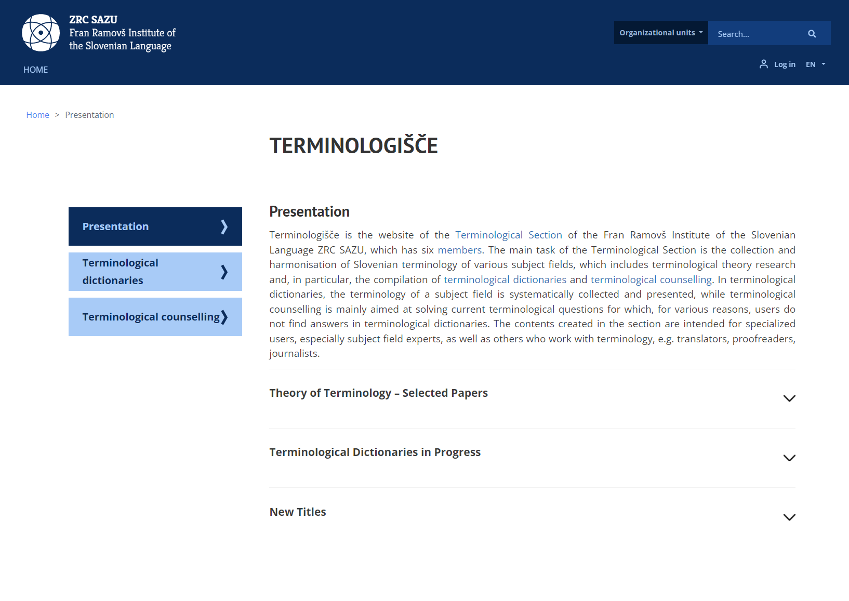
https://isjfr.zrc-sazu.si/sl/terminologisce

Slide 13
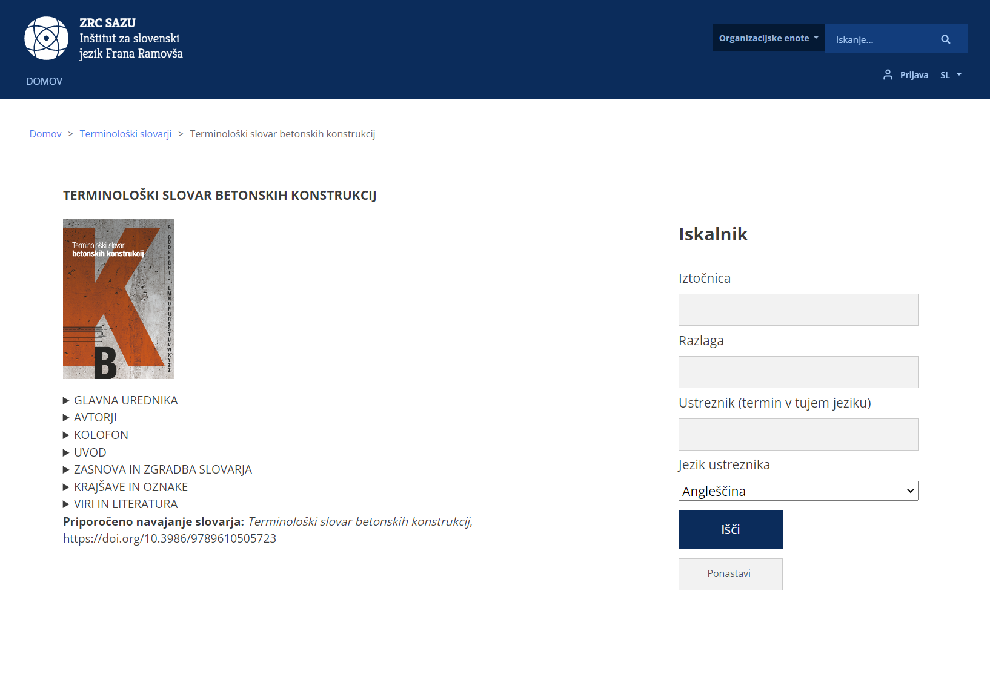

Slide 14
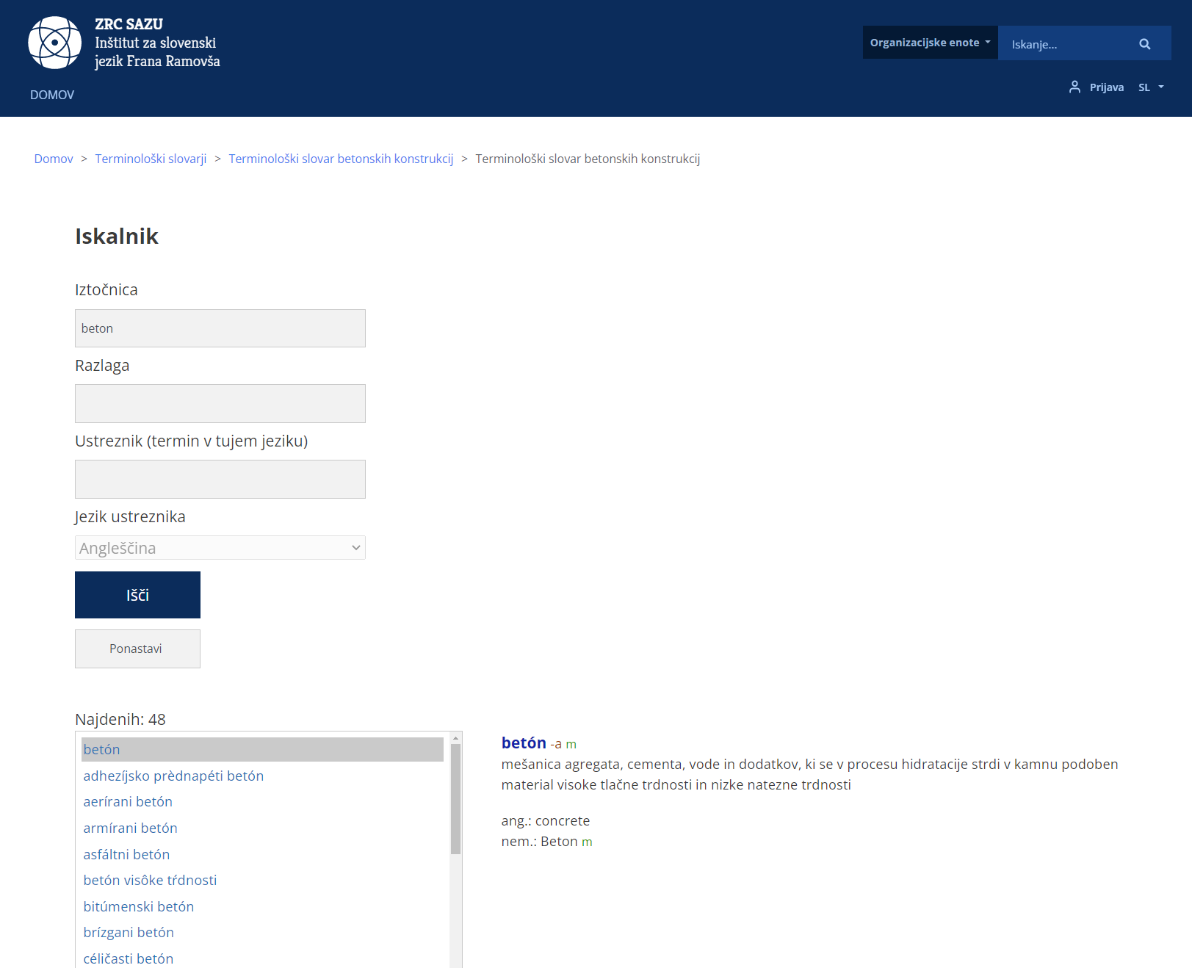

Slide 15
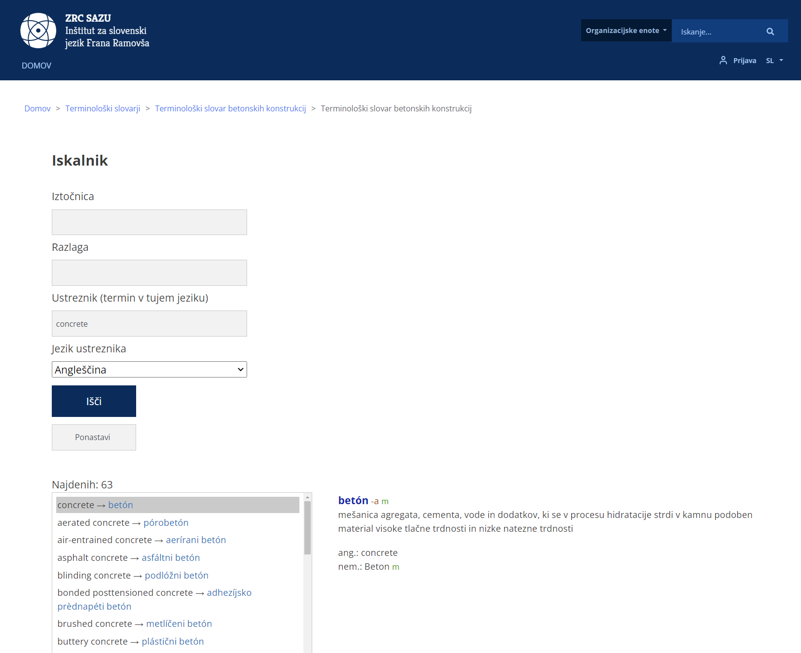

Slide 16
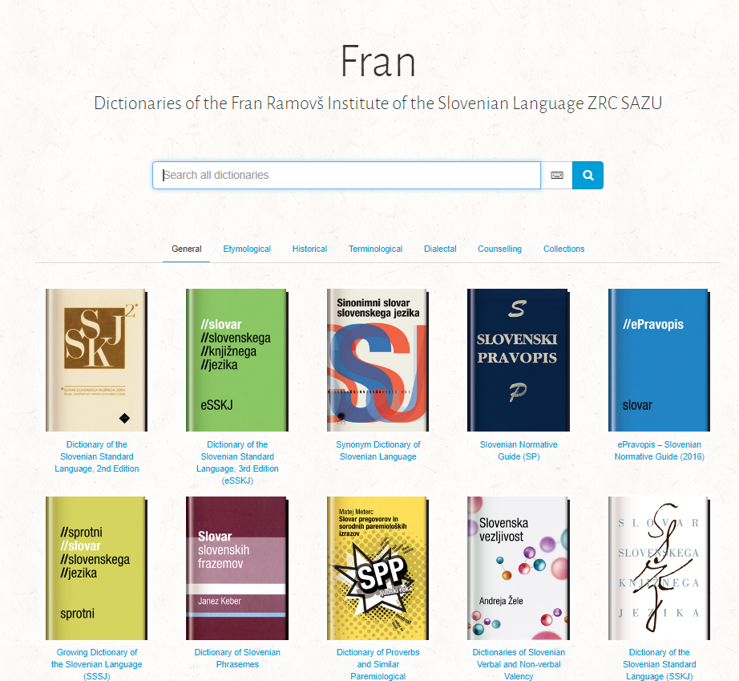

Slide 17
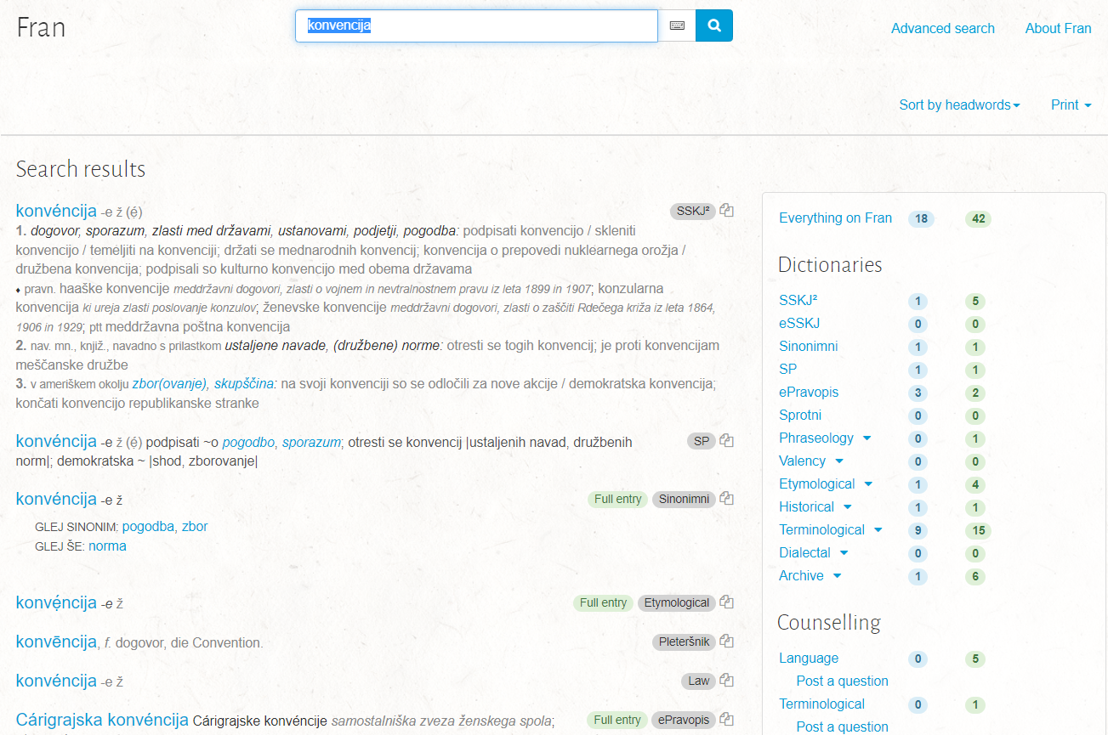

Slide 18
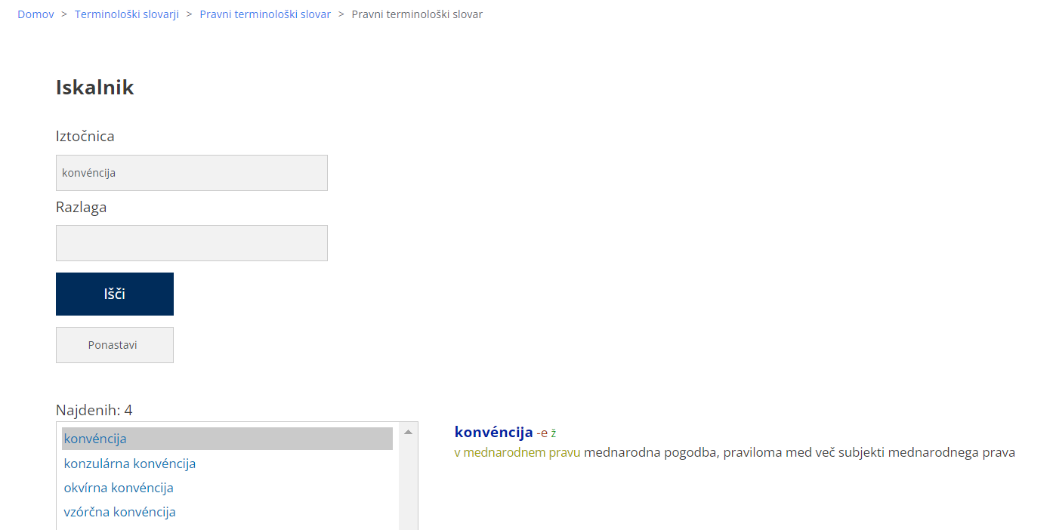

Slide 19
Terminological dictionaries
Intended users: experts (of a particular subject field)
  Other users: translators, language editors, journalists etc.
A terminologist + group of experts
  A terminologist organises terminological work, compiles a specialised corpus, extracts terms and prepares a word list (in cooperation with experts), takes care of the coherence of the concept system and any eventual inconsistencies
  Experts have knowledge about concepts and concept system of their own subject field, so they are responsible for reliable definitions and for foreign-language equivalents
Conceptual approach (but usage is not ignored)
Terminological agreement normative choices

Slide 20
Terminological Counselling Service
Web-based service on Terminologišče, free of charge
Since 2013 (previously by phone, e-mail …)
Around 60-70 terminological questions per year, constantly growing
Intended for experts with existent terminological problems
Many terminological questions come from translators and language editors
The questions are usually not trivial
All terminologists are involved – we discuss each terminological problem and try to find the best solution together
We always decide on one (preferred) term and write arguments for our decision

Slide 21
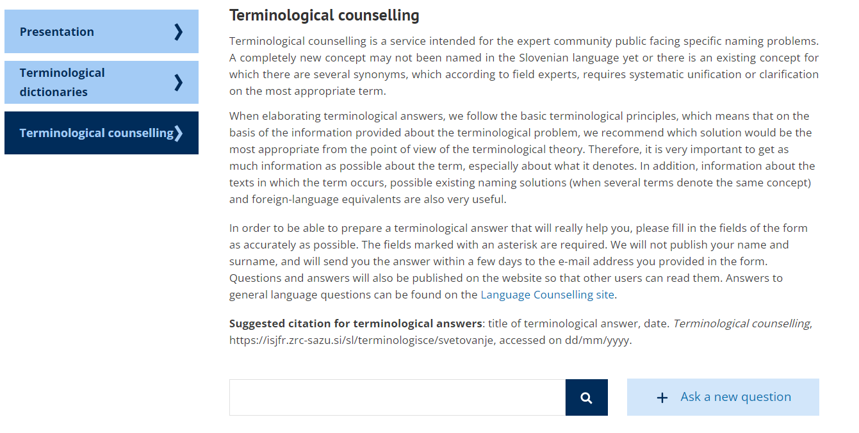
https://isjfr.zrc-sazu.si/en/terminologisce/svetovanje

Slide 22
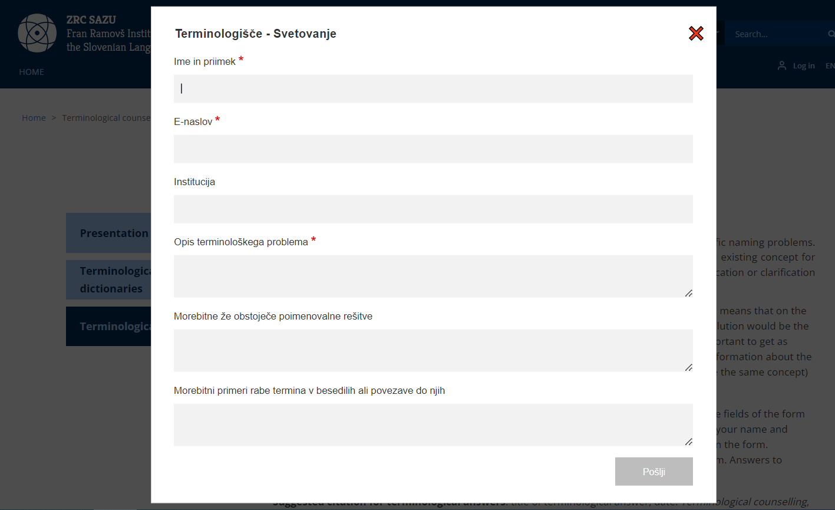

Slide 23
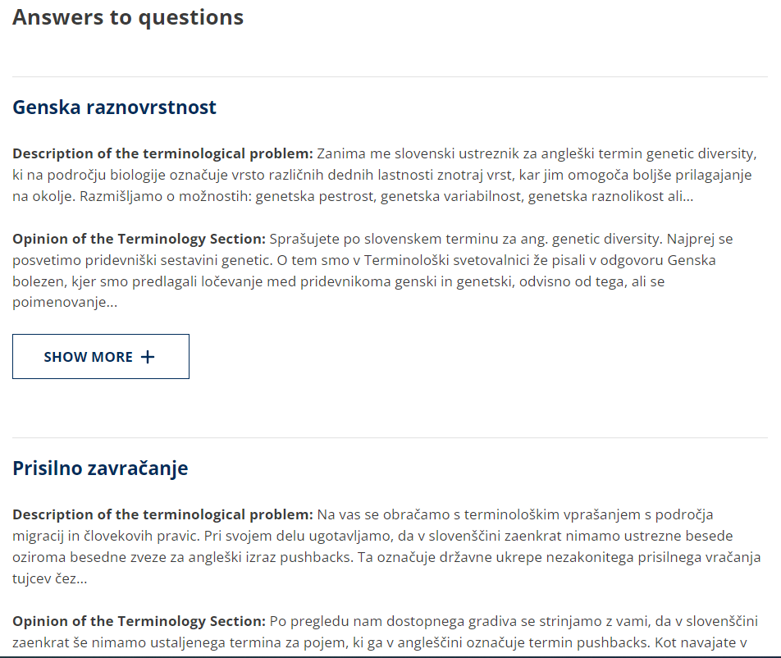

Slide 24
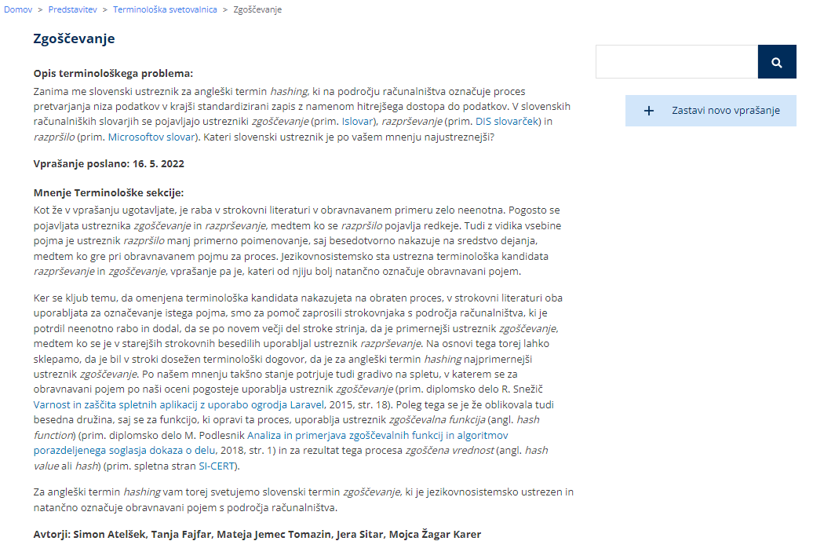

Slide 25
Terminological Counselling Service
Two types of questions:
The English term X is defined as ... I need to find an adequate Slovenian term. Please help.
For the concept defined as ... there are 3 different terms in Slovenian. Which of these do you think is the most appropriate?

Slide 26
Terminology principles
The preferred term should be:
well established (often used in specialised texts)
economical (relatively short)
linguistically adequate
of domestic origin*
TERMINOLOGY PRINCIPLES SHOULD NOT BE USED MECHANICALLY!

Slide 27
